Slide 1
Learning the Problem Space from Primitives
James Kirk
Soar Workshop 2017

Slide 2
What is the Problem Space?
Newell: set of initial states, final states, operators over the space, and path constraints
Goals (Initial and final states)
Learning State description
Actions (Operators)
Learning preconditions
Not action models or how to perform
Failure conditions (Path constraints)
Learning illegal states descriptions
Not yet explored learning
Illegal/required operator(s)
Illegal/required sequences of states and/or operators

Slide 3
Characteristics from ITL
Humans are extremely good at Rapid Interactive Task Learning (RITL)
if we want systems working in coordination with humans this ability is necessary
constrained by ITL characteristics must be:
interactively learnable
Incremental (transfer)
Online (fast, continuous learning and action)
Responsive (efficient)
need to learn efficient representations
native, not interpretive, general, transferable, nonconflicting, compositional/hierarchical

Slide 4


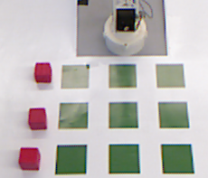
Problem Space Decomposition
Task Problem Space
What vocabulary does Rosie know?
How is that vocab defined?
What is Rosie’s representation of the world?
What relevant knowledge has Rosie already learned?
Goals
Failure conditions
Actions
???
Agent (Primitive) Knowledge
Notes:
Initial structure is stored in semantic memory

Slide 5

Research Problems
Assuming Rosie has sufficient primitive knowledge to understand a problem:
How do we ground, or link, the humans’ explanation (the sentences, vocab, and their intended meanings) of the problem space to those agent primitives
…in an efficient manner though situated Interactive Task Learning
…(into computable and efficient representations that are also general, transferable, and composable.) *
*Not talking about 3 in talk, which is supported by chunking
Notes:
Initial structure is stored in semantic memory

Slide 6
One Agent World Representation
12
15
Primitives
7
8
9
Action: move
Prepositions: on, linear
Attributes: color(red,blue), category(block,location)
Operations: equals, has attribute, number of (count)
Objects 1-9: category=location
Objects 10-12: color=red, category=block
Objects 13-15: color=blue, category=block
On : (10,1); (11,4); (13,5); (14,6)
Linear : (1,2,3); (1,4,9); (2,5,8); (3,6,9); (1,5,9); (3,5,7)
11
13
14
4
5
6
10
1
2
3
Notes:
Initial structure is stored in semantic memory

Slide 7
The name of the game is Tic-Tac-Toe.
Rosie: Please setup the game.
You can move a red block that is not on a location onto a location that is not below a block.
[…oops no below...]
12
15
7
8
9
Objects 1-9: category=location
Objects 10-12: color=red, category=block
Objects 13-15: color=blue, category=block
On : (10,1); (11,4); (13,5); (14,6)
Linear : (1,2,3); (1,4,9); (2,5,8); (3,6,9); (1,5,9); (3,5,7)
11
13
14
4
5
6
10
1
2
3

Slide 8
Why don’t we want to just
…teach directly from primitives, if assuming known
For complex concepts, it is hard to parse/construct sentence (many similar objects and lots of combinations of relations)
Hard to process these “flat” representation efficiently
No hope for good transfer
…preload these the composition of concepts(include as primitives)
Some we probably would, but brittle to any changes in agent design or environment
Even if we could prestore all possible lexical info, how to detect (semantics) is often task dependent and relying on the particular usage/context/available sensing

Slide 9
The name of the game is Tic-Tac-Toe.
Rosie: Please setup the game.
You can move a free piece that is yours onto a clear location.
move
Semantic Structure Legend
Verbs
Primitive concepts
Learned concepts
Input Arguments
on-to
yours
clear
free
location
piece
12
15
7
8
9
Objects 1-9: category=location
Objects 10-12: color=red, category=block
Objects 13-15: color=blue, category=block
On : (10,1); (11,4); (13,5); (14,6)
Linear : (1,2,3); (1,4,9); (2,5,8); (3,6,9); (1,5,9); (3,5,7)
11
13
14
4
5
6
10
1
2
3

Slide 10
Learning new task vocabulary
concept
Semantics
Syntax
How to detect
Application
POS: ADJ, PREP, NOUN, ETC.
spelling
Arity
(# of arguments)
Conjunction Of concepts
Informed by: POS/context/usage
Syntax ←→ Semantics (many to many)
Notes:
Initial structure is stored in semantic memory

Slide 11
The name of the game is Tic-Tac-Toe.
Rosie: Please setup the game.
You can move a free piece that is yours onto a clear location.
Rosie: I don’t know the concept piece.
move
on-to
yours
clear
Resolve Bottom Up
free
1-9
location
piece
12
15
Legend
Verbs
Primitive concepts
Learned concepts
Input Arguments
7
8
9
Objects 1-9: category=location
Objects 10-12: color=red, category=block
Objects 13-15: color=blue, category=block
On : (10,1); (11,4); (13,5); (14,6)
Linear : (1,2,3); (1,4,9); (2,5,8); (3,6,9); (1,5,9); (3,5,7)
11
13
14
4
5
6
10
1
2
3

Slide 12
The name of the game is Tic-Tac-Toe.
Rosie: Please setup the game.
You can move a free piece that is yours onto a clear location.
Rosie: I don’t know the concept piece.
If an object is a block then it is a piece.
move
on-to
yours
clear
free
1-9
10-15
location
10-15
piece
block
12
15
Legend
Verbs
Primitive concepts
Learned concepts
Input Arguments
7
8
9
Objects 1-9: category=location
Objects 10-12: color=red, category=block
Objects 13-15: color=blue, category=block
On : (10,1); (11,4); (13,5); (14,6)
Linear : (1,2,3); (1,4,9); (2,5,8); (3,6,9); (1,5,9); (3,5,7)
11
13
14
4
5
6
10
1
2
3

Slide 13
The name of the game is Tic-Tac-Toe.
Rosie: Please setup the game.
You can move a free piece that is yours onto a clear location.
Rosie: I don’t know the concept free.
An object that is not on a location is free.
move
on-to
yours
clear
~on
free
1-9
10-15
1-9
10-15
location
input1
location
piece
12
15
Legend
Verbs
Primitive concepts
Learned concepts
Input Arguments
7
8
9
Objects 1-9: category=location
Objects 10-12: color=red, category=block
Objects 13-15: color=blue, category=block
On : (10,1); (11,4); (13,5); (14,6)
Linear : (1,2,3); (1,4,9); (2,5,8); (3,6,9); (1,5,9); (3,5,7)
11
13
14
4
5
6
10
1
2
3

Slide 14
The name of the game is Tic-Tac-Toe.
Rosie: Please setup the game.
You can move a free piece that is yours onto a clear location.
Rosie: I don’t know the concept free.
An object that is not on a location is free.
move
on-to
yours
12,15
12,15
clear
~on
free
1-9
10-15
1-9
10-15
location
input1
location
piece
12
15
Legend
Verbs
Primitive concepts
Learned concepts
Input Arguments
7
8
9
Objects 1-9: category=location
Objects 10-12: color=red, category=block
Objects 13-15: color=blue, category=block
On : (10,1); (11,4); (13,5); (14,6)
Linear : (1,2,3); (1,4,9); (2,5,8); (3,6,9); (1,5,9); (3,5,7)
11
13
14
4
5
6
10
1
2
3

Slide 15
The name of the game is Tic-Tac-Toe.
Rosie: Please setup the game.
You can move a free piece that is yours onto a clear location.
Rosie: I don’t know the concept yours.
If a piece is red then it is yours.
move
on-to
12
12
red
yours
12,15
12,15
clear
input1
free
1-9
10-15
location
piece
12
15
Legend
Verbs
Primitive concepts
Learned concepts
Input Arguments
7
8
9
Objects 1-9: category=location
Objects 10-12: color=red, category=block
Objects 13-15: color=blue, category=block
On : (10,1); (11,4); (13,5); (14,6)
Linear : (1,2,3); (1,4,9); (2,5,8); (3,6,9); (1,5,9); (3,5,7)
11
13
14
4
5
6
10
1
2
3

Slide 16
You can move a free piece that is yours onto a clear location.
Rosie: I don’t know the concept clear.
A location that is not below an object is clear.
Rosie: I don’t know the concept below.
move
12
on-to
yours
~below
12,15
clear
1-9
10-15
free
1-9
input1
block
10-15
location
piece
12
15
Legend
Verbs
Primitive concepts
Learned concepts
Input Arguments
7
8
9
Objects 1-9: category=location
Objects 10-12: color=red, category=block
Objects 13-15: color=blue, category=block
On : (10,1); (11,4); (13,5); (14,6)
Linear : (1,2,3); (1,4,9); (2,5,8); (3,6,9); (1,5,9); (3,5,7)
11
13
14
4
5
6
10
1
2
3

Slide 17
You can move a free piece that is yours onto a clear location.
Rosie: I don’t know the concept clear.
A location that is not below an object is clear.
Rosie: I don’t know the concept below.
If a block is on a location then the location is below the block.
move
(10,1), (11,4), (13,5), (14,6)
12
on-to
2,3,7,8,9
on
yours
~below
10-15
1-9
12,15
clear
1-9
10-15
input2
input1
free
1-9
input1
block
10-15
location
piece
12
15
Legend
Verbs
Primitive concepts
Learned concepts
Input Arguments
7
8
9
Objects 1-9: category=location
Objects 10-12: color=red, category=block
Objects 13-15: color=blue, category=block
On : (10,1); (11,4); (13,5); (14,6)
Linear : (1,2,3); (1,4,9); (2,5,8); (3,6,9); (1,5,9); (3,5,7)
11
13
14
4
5
6
10
1
2
3

Slide 18
You can move a free piece that is yours onto a clear location.
Rosie: I don’t know the concept clear.
A location that is not below an object is clear.
move
(10,1), (11,4), (13,5), (14,6)
12
on-to
2,3,7,8,9
on
yours
2,3,7,8,9
~below
10-15
1-9
12,15
clear
1-9
10-15
input2
input1
free
1-9
input1
block
10-15
location
piece
12
15
Legend
Verbs
Primitive concepts
Learned concepts
Input Arguments
7
8
9
Objects 1-9: category=location
Objects 10-12: color=red, category=block
Objects 13-15: color=blue, category=block
On : (10,1); (11,4); (13,5); (14,6)
Linear : (1,2,3); (1,4,9); (2,5,8); (3,6,9); (1,5,9); (3,5,7)
11
13
14
4
5
6
10
1
2
3

Slide 19
The name of the goal is three-in-a-row.
Rosie: Please setup the goal state.
The goal is that three linear locations are captured.
equals
count
“3”
captured
linear
locations
15
12
Objects 1-9: category=location
Objects 10-12: color=red, category=block
Objects 13-15: color=blue, category=block
On : (10,1); (11,4); (13,5); (14,6)
Linear : (1,2,3); (1,4,9); (2,5,8); (3,6,9); (1,5,9); (3,5,7)
Legend
Primitive concepts
Learned concepts
Input Arguments
7
8
9
11
13
14
4
5
6
10
1
2
3

Slide 20
The name of the goal is three-in-a-row.
Rosie: Please setup the goal state.
The goal is that three linear locations are captured.
Rosie: I don’t know the concept captured.
If a location is below a piece that is yours then the location is captured.
equals
count
“3”
(1,4,7)
below
captured
(1,2,3)…
10-12
(1,2,3); …(3,5,7)
input1
yours
linear
10-15
1-9
piece
locations
15
12
Objects 1-9: category=location
Objects 10-12: color=red, category=block
Objects 13-15: color=blue, category=block
On : (10,1); (11,4); (13,5); (14,6)
Linear : (1,2,3); (1,4,9); (2,5,8); (3,6,9); (1,5,9); (3,5,7)
Legend
Primitive concepts
Learned concepts
Input Arguments
7
8
9
11
13
14
4
5
6
10
1
2
3

Slide 21
The name of the goal is three-in-a-row.
Rosie: Please setup the goal state.
The goal is that three linear locations are captured.
Rosie: I don’t know the concept captured.
If a location is below a red piece that is yours then the location is captured.
equals
3
count
“3”
(1,4,7)
(1,4,7)
below
captured
(1,2,3)…
10-12
(1,2,3); …(3,5,7)
input1
yours
linear
10-15
1-9
piece
locations
15
12
Objects 1-9: category=location
Objects 10-12: color=red, category=block
Objects 13-15: color=blue, category=block
On : (10,1); (11,4); (13,5); (14,6)
Linear : (1,2,3); (1,4,9); (2,5,8); (3,6,9); (1,5,9); (3,5,7)
Legend
Primitive concepts
Learned concepts
Input Arguments
7
8
9
11
13
14
4
5
6
10
1
2
3

Slide 22
Same Game, Different Representation
Primitives
Action: write
Prepositions: linear
Attributes: category(location)
Operations: equals, has attribute, number of (count)
Object 1: category=location, value = “X”
Object 2: category=location
Object 3: category=location
Object 4: category=location, value = “X”
Object 5: category=location, value = “O”
Object 6: category=location, value = “O”
Object 7: category=location
Object 8: category=location, value = “X”
Object 9: category=location, value = “O”
Linear : (1,2,3); (1,4,9); (2,5,8); (3,6,9); (1,5,9); (3,5,7)
X
O
7
8
9
X
O
O
4
5
6
X
1
2
3
Notes:
Initial structure is stored in semantic memory

Slide 23
The name of the game is XO-Tic-Tac-Toe.
Rosie: Please setup the game.
You can write a “X” onto a clear location.
Rosie: I couldn’t satisfy the concept clear, could you give another definition?
write
‘X’
on-to
“X”
~below
clear
1-9
1-9
input1
block
location
Legend
Verbs
Primitive concepts
Learned concepts
Input Arguments
X
O
Objects 1, 4, 8: category=location, value = “X”
Objects 2, 3, 7: category=location
Objects 5, 6, 9: category=location, value = “O” Linear : (1,2,3); (1,4,9); (2,5,8); (3,6,9); (1,5,9); (3,5,7)
7
8
9
X
O
O
4
5
6
X
2
1
3

Slide 24
The name of the game is XO-Tic-Tac-Toe.
Rosie: Please setup the game.
You can write a “X” onto a clear location.
Rosie: I couldn’t satisfy the concept clear, could you give another definition?
If the value of a location is absent then the location is clear.
write
‘X’
on-to
2,3,7
“X”
2,3,7
~has attribute
clear
1-9
‘value’
1-9
input1
“value”
location
‘X’
Legend
Verbs
Primitive concepts
Learned concepts
Input Arguments
X
O
Objects 1, 4, 8: category=location, value = “X”
Objects 2, 3, 7: category=location
Objects 5, 6, 9: category=location, value = “O” Linear : (1,2,3); (1,4,9); (2,5,8); (3,6,9); (1,5,9); (3,5,7)
7
8
9
X
O
O
4
5
6
X
2
1
3

Slide 25
The name of the goal is three-in-a-row.
Rosie: Ok I know that goal.
Rosie: I couldn’t satisfy the concept captured, could you give another definition?
equals
count
“3”
below
captured
(1,2,3)…
(1,2,3); …(3,5,7)
input1
yours
linear
piece
1-9
block
locations
X
X
O
Objects 1, 4, 8, 7: category=location, value = “X”
Objects 2, 3: category=location
Objects 5, 6, 9: category=location, value = “O” Linear : (1,2,3); (1,4,9); (2,5,8); (3,6,9); (1,5,9); (3,5,7)
Legend
Primitive concepts
Learned concepts
Input Arguments
7
8
9
X
O
O
4
5
6
X
2
1
3

Slide 26
The name of the goal is three-in-a-row.
Rosie: Ok I know that goal.
Rosie: I couldn’t satisfy the concept captured, could you give another definition?
If the value of a location is “X” then the location is captured.
equals
3
count
“3”
(X,X,X),(1,4,7)
(1,4,7)
equals
captured
(X,O,O),(1,5,9);…
(1,2,3); …(3,5,7)
value of
“X”
linear
(1,5,9)…
1-9
input1
locations
X
X
O
Objects 1, 4, 8, 7: category=location, value = “X”
Objects 2, 3: category=location
Objects 5, 6, 9: category=location, value = “O” Linear : (1,2,3); (1,4,9); (2,5,8); (3,6,9); (1,5,9); (3,5,7)
Legend
Primitive concepts
Learned concept
Input Arguments
7
8
9
X
O
O
4
5
6
X
2
1
3

Slide 27
Classification of the new vocabulary
Based on what the available primitive knowledge is
Color, shape, size, names, volume, weight, value
Prepositions (on, behind, under, below, left of)
Numerical functions (number of, sum of)
Comparitors (less than, more than)
Types of Learnable concepts are an extension of the types of the supported primitives
but could change or add new primitives to learn different concepts
Also can be classified by Part of Speech
adjectives, nouns, prepositions, possessive pronouns, state verbs
Notes:
Initial structure is stored in semantic memory

Slide 28
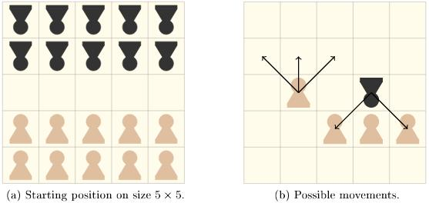
Overloading within same task (Breakthrough)
You can move a red block onto a location that is capturable by the block.
Rosie: I don’t know the concept capturable.
If a captured location is under a clear location then the clear location is capturable by a block on the captured location.
Rosie: Ok I’ve learned the concept capturable.
Rosie: Ok I’ve learned the action.
Your opponent can move a blue block onto a location that is capturable by the block.
Rosie: I couldn’t satisfy the concept capturable. Could you give me another definition?
If an occupied location is above a clear location then the clear location is capturable by the occupant of the occupied location.
Notes:
Initial structure is stored in semantic memory

Slide 29
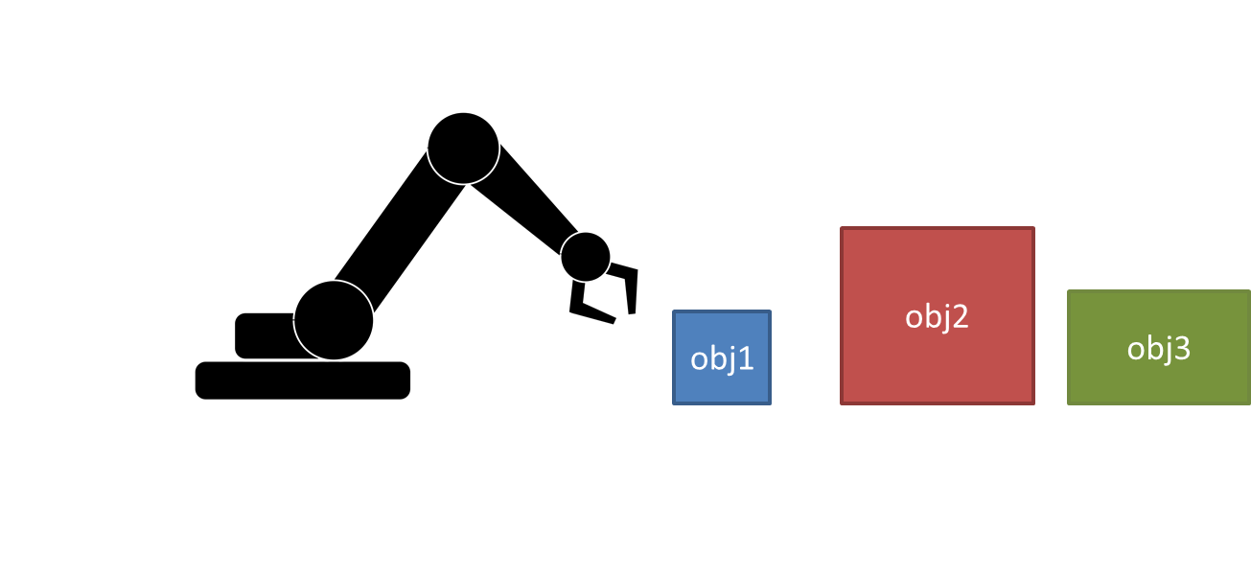
Supports learning heuristics
Prefer moving the smallest object.
Rosie: I don’t know the concept smallest.
If an object is not larger than any other object then it is the smallest.
Rosie: I don’t know the concept larger.
If the volume of a block is more than the volume of an object then the block is larger than the object.
Prefer (>)
move
(7.5, 5), (7.5, 3.5), (5, 3.5)
1
1
~larger
more-than
smallest
1,2,3
1,2,3
3.5, 7.5, 5
3.5, 7.5, 5
1,2,3
input1
object
volume of
volume of
object
1,2,3
1,2,3
input1
input2
Object 1: color=blue, category=object, volume = 3.5
Object 2: color=red, category=object, volume = 7.5
Object 3: color=green, category=object, volume = 5

Slide 30

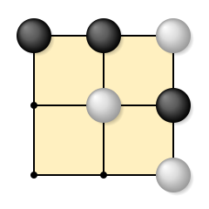
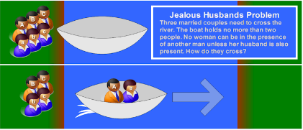
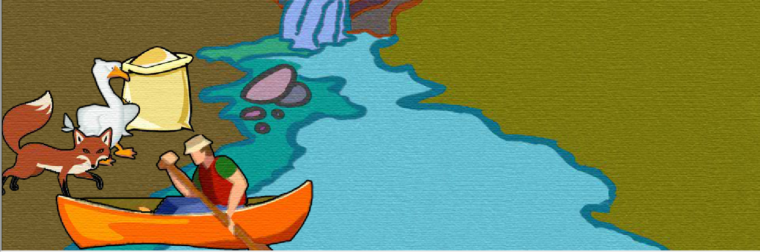
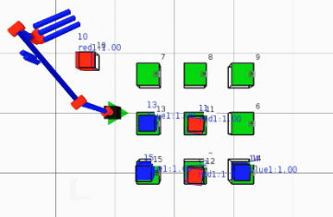
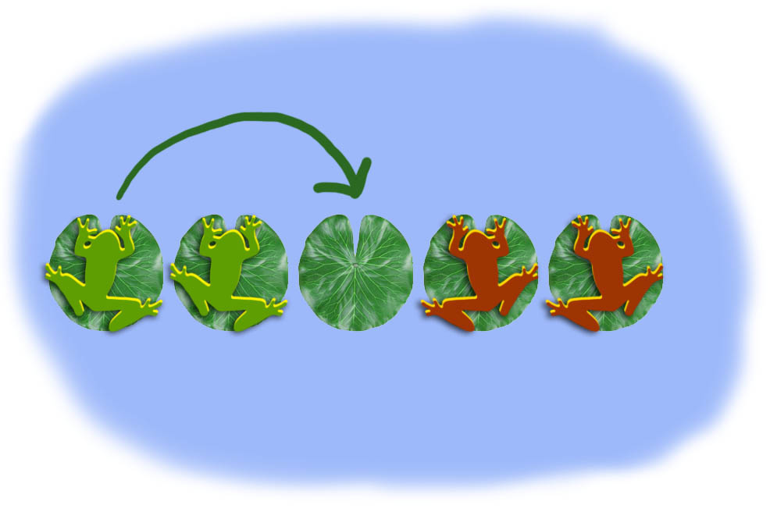
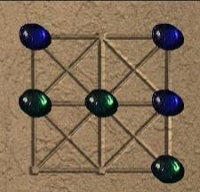
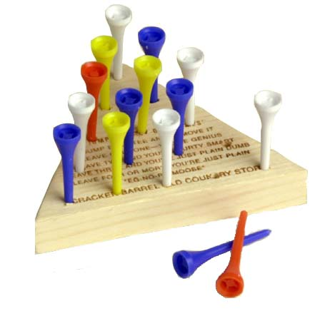
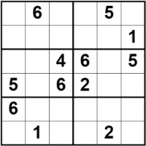
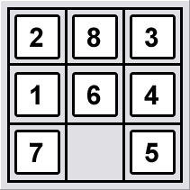
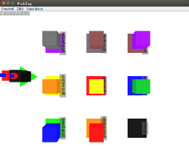
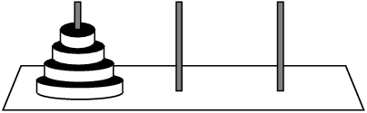
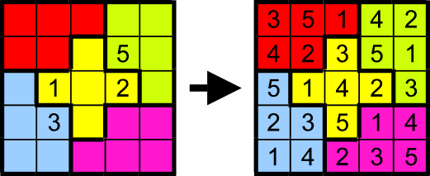
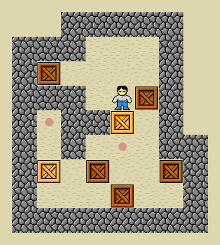
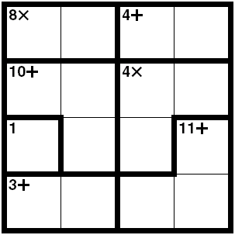
30+ Games and Puzzles
Missionaries and Cannibals
Jealous Husbands problem
Family River crossing
Fox, Goose, & Beans
Frogs and Toads puzzle
Stacking frogs puzzle
King/Lazy Stacking frogs
Peg Solitaire
Eight Puzzle(Five, Fifteen)
Five/Eight Puzzle Color Isomorph
Tower of Hanoi (3 ,4, & 5 Blocks)
Mahjong Solitaire
Simple Maze
Block pushing Maze
Sokoban
Various Blocks World puzzles
Tic-Tac-Toe/Blocks Tic-Tac-Toe
Connect-3/Connect-4
Othello
Breakthrough
Three Men’s Morris
Picaria
Nine Holes
Simplified Risk
President card game
Crazy Eights
Sudoku (small versions)
Killer Sudoku
Jigsawdoku
Logi-5
KenKen/Calcudoku

Slide 31
Nuggets and Coals
Nuggets
Can learn large number of concepts and supporting semantics
Supports the learning of many more actions, goals, heuristics, and games
Learning intermediate hierarchies of concepts/semantics allows for deep/multi level transfer between tasks and domains
Coals
Don’t yet have general strategies for learning the correct syntax (POS) of new concepts
No support yet for disjunctions (if it is x or y) (learn multiple rules!)
Cannot use past events, actions to describe concepts, states (Using epmem)

Slide 32
Bonus Slides

Slide 33
Procedural knowledge for resolving “object”
RULE:
Prefer (>)
If:
predicate P
has name <object> and type <category>
and input A
And A has property <category> <object>
Then:
A is a result of P
move
smallest
obj1,obj2,obj3
object
Obj1: color=blue, category=object, volume = 3.5
Obj2: color=red, category=object, volume = 7.5
Obj3: color=green, category=object, volume = 5

Slide 34
Procedural knowledge for resolving “volume of”
RULE:
If:
predicate P
has name <volume> and type <attribute-of>
and input A
and A has property <volume> X
Then:
X is a result of P
3.5, 7.5, 5
more-than
volume of
volume of
input1
input2
obj1,obj2,obj3
Obj1: color=blue, category=object, volume = 3.5
Obj2: color=red, category=object, volume = 7.5
Obj3: color=green, category=object, volume = 5

Slide 35
Procedural knowledge for resolving “more than”
RULE:
(7.5, 5), (7.5, 3.5), (5, 3.5)
If:
predicate P
has name <more> and type <comparison>
and inputs A and B
and A > B
Then:
(A,B) is a result of P
3.5, 7.5, 5
more-than
3.5, 7.5, 5
volume of
volume of
input1
input2
obj1,obj2,obj3
obj1,obj2,obj3
Obj1: color=blue, category=object, volume = 3.5
Obj2: color=red, category=object, volume = 7.5
Obj3: color=green, category=object, volume = 5

Slide 36
Procedural knowledge for resolving “prefer ” action
Available proposed actions:
Move(obj1), Move(obj2), Move(obj3)
RULE:
> move(obj1)
If:
action A proposed in state S
has name <move>
and input B
and B is smallest
Then:
Prefer(>) A in state S
Prefer (>)
move
obj1
smallest
object
obj1,obj2,obj3
Obj1: color=blue, category=object, volume = 3.5
Obj2: color=red, category=object, volume = 7.5
Obj3: color=green, category=object, volume = 5

Slide 37
Second Example: (RISK)
Prefer attacking a location over attacking an object that is stronger than the location.
Rosie: I don’t know the concept stronger.
If the number of blocks on a location is more than the number of blocks on an object then the location is stronger than the object.
Prefer (>)
attack
attack
stronger
1
object
more-than
location
2
count
count
on
on
blocks
input1
blocks
input2
Semantics Legend
Verbs
Primitive concepts
Learned concept
Input Arguments

Slide 38
Nine Parts of Speech
Noun (Learnable) ex: frog, box, missionary, grape, husband of, neighbor of
Adjective (Learnable) ex: clear, free, captured, defendable, weak, shapeless
Comparative ADJ ex: larger than, heavier than, colder than (C-ADJ-P?)
Superlative ADJ ex: hottest, largest, highest, worst, top
Verb
Action Verbs (Fixed here) Learnable through Aaron/Shiwali’s work
Occurrence Verbs (Not) ex: happened, became
State Verbs (Learnable) ex: protected by, captured by, surrounded by, supporting, defending, jumpable by
Adverb (Not) possibly could be with deeper knowledge of verbs
Pronoun (Learnable) Possessive pronouns ex: yours, your, theirs
Preposition (Learnable) ex: on, below, under, adjacent to, movable to?
Conjunction (Not) ex: and, but
Article/Determiner (Not) ex: an, an, the
Interjection (Not) Huh?
Notes:
(Possessive prounoun: your learnable but as ADJ…, If a block is red then it is your block.
Some current discrepancies between this structure-types from parser in order to get to work
–by verbs= C-ADJ, supporting = PP,… not versed with V structure type…

